Slide 1
Communication
UTSA Campus Recreation

Slide 2
Outline
What we will cover
Conflict Resolution/ Managing Team Conflict
Thomas Kilman Model
Cooperation in Campus Rec
Job Expectations
Ask for Help
Customer Service
Dealing with upset patrons
Scenarios

Slide 3
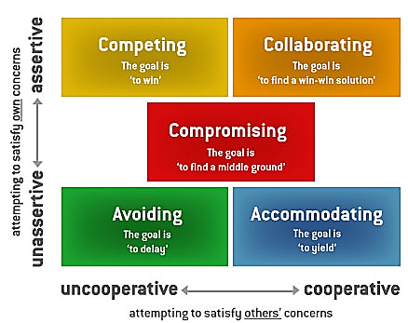
Conflict Resolution & Managing Team Conflict
The Thomas Kilman model identifies two dimensions when choosing a course of action in a conflict situation, these are assertiveness and cooperativeness.
Assertiveness is the degree to which you try to satisfy your own needs.
Cooperativeness is the degree to which you try to satisfy the other person's concerns.

Slide 4
Conflict Resolution & Managing Team Conflict cont’d . . .
Avoiding – You prefer not to face stressful situations. (please allow a few seconds for the video to fully load and then click the play button)
This style is best used when dealing with emotionally charged situations.
Ex. Dealing with team member who is clearly upset and being irrational in the moment.

Slide 5
Conflict Resolution & Managing Team Conflict cont’d . . .
Accommodating – Beneficial to preserve the harmony. (please allow a few seconds for the video to fully load and then click the play button)
This style is best used when preserving a relationship is more important than winning the issue at hand.
(Ex. Giving a patron a different towel if they perceive the towel they were given is dirty.)

Slide 6
Conflict Resolution & Managing Team Conflict cont’d . . .
Competing – You only aim to pursue your own goal. (please allow a few seconds for the video to fully load and then click the play button)
This style is best used when have greater expertise/better information or outcome is critical and right decision may be unpopular.
(Ex. A team member lets a non-approved patron into the Rec. The Supervisor uses their authority to write up team for not adhering to our policy.

Slide 7
Conflict Resolution & Managing Team Conflict cont’d . . .
Compromising – Finding a solution that partially satisfies both individuals. (please allow a few seconds for the video to fully load and then click the play button)
This style is best used when each team member is willing to give up something or meeting everyone’s needs may not be realistic.
(Ex. Supervisor schedules all team members to work one weekend so not only one person is working every weekend. )

Slide 8
Conflict Resolution & Managing Team Conflict cont’d . . .
Collaborating – You are willing to understand the other person’s POV and come to a mutual decision. (please allow a few seconds for the video to fully load and then click the play button)
This style is best used when there’s sufficient time to engage and look at solutions from different perspectives.
(Ex. Supervisor works with team member to get their last 30mins covered on Wednesdays so they can attend a weekly SI session.)

Slide 9
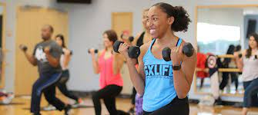
Cooperation in Campus Rec
Campus Recreation has updated and modified our policies, guidelines, and safety protocols in accordance with the University. These changes will ensure that we are following the most current information for the safety of patrons and staff. It is important that we are all working cohesively and on the same page.
The Campus Recreation Professional Staff has created a re-opening plan that will help us navigate through our different phases of opening. For us to be successful, we must all be flexible and willing to adapt. We are all in this together. If for any reason you have concerns or need additional training, ASK FOR HELP!

Slide 10
Cooperation in Campus Rec
Be ready for
Updated area-specific training
Mandated University Student & Staff training
Additional Safety protocols
Learning new skills/ cross-training
Helping patrons understand new University guidelines

Slide 11
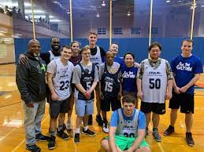
Don’t Struggle in Silence (Ask for Help)
Our purpose is to enrich personal well-being. This not only means our patrons and guests, but for our staff as well. Your well-being is of utmost important to the Professional Staff at Campus Recreation. We want you to know that we care and want the best for each one of our staff members.
We want to encourage our staff members to take ownership of their well-being. This not only includes your physical health but for all the 8 dimensions of Well-Being (Emotional, Spiritual, Intellectual, Physical, Environmental, Financial, Occupational, and Social).

Slide 12
Don’t Struggle in Silence (Ask for Help)
If you need help
UTSA Counseling & Mental Health Services
Phone or video conference call (210) 258-4140
Conversation with Supervisor
Review trainings
Discuss concerns
Other resources
Family
Friend
Co-worker
Spiritual leader

Slide 13
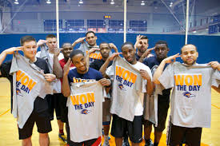
Customer Service
Now more than ever, we must communicate with our patrons, visitors, and guests. It is our responsibility that we uphold our policies, protocols, and University guidelines for the safety our patrons and for ourselves. In doing so, we must remember to be friendly, approachable, kind, and understanding.

Slide 14
Customer Service
Follow these tips when dealing with upset patrons.
Always be professional, positive, and respectful
Approach in a friendly manner
Remain neutral and don’t take it personal
Listen without interrupting
Collect details by taking notes when they speak
Apologize ‘appropriately’
Confirm their concerns and repeat back
Offer choices on how to resolve the situation

Slide 15
Customer Service
Read the scenario and answer the multiple choice.

Slide 16
Customer Service
Scenario #1 – A patrons is working out with headphones in and does not hear that we are closing in 5 minutes. They are currently in the middle of a set using the squat rack.
You should:
Try and yell at the patron that we are closing and they need to leave.
Tap them on the shoulder and tell them to rack the weigh and leave.
Start taking the weigh off the bar and tell them they cannot finish.
Politely get their attention and inform them we are closing shortly.

Slide 17
Customer Service
Correct Answer is D.
When addressing a patron who is actively working out we want to make sure the patron is safe and not distracted while holding weight. When it is safe for both the patron and our staff, get the attention of the patron and inform them the Rec is getting ready to close.

Slide 18
Customer Service
Scenario #2 – A patron comes to you and says they have lost their UTSA ID while at the Rec. They have already looked everywhere they have been and still could not find their ID.
You should tell the patron:
To check in lost and found at the Member Services desk and let the patron know they can also get a new ID on-campus at the Campus Services office.
Maybe you should have watched it more closely.
I have not seen an ID. Sorry about that.
Go check again, maybe you missed a spot.

Slide 19
Customer Service
Correct Answer is A.
It is important that we do our best to help all our patrons. Losing your UTSA ID card can be stressful. Letting our patrons know about Lost and Found and assuring them that they can get another card can help de-stress the situation.

Slide 20
Customer Service
Scenario #3 – An upset patron comes up to you to complain. They tell you that there are too many people who are not wearing masks.
You should tell the patron:
Sorry, what do you want me to do about it?
I understand that you are upset and may feel uneasy about patrons not wearing masks. The University guidelines for our facility is that masks are strongly recommended but not required. You may be better accommodated during our non-peak hours when less patrons are using the facility. Campus Recreation also does multiple sanitations of our facility throughout the day.
Just try not to stand next to patrons who are not wearing a mask.

Slide 21
Customer Service
Correct Answer is B.
When patrons are upset it is important to listen and acknowledge that you are listening, without interrupting them. Most of the times patrons just want to feel like they have been heard. Collect as many details as you can and repeat back what they said. If possible, offer choices to resolve the situation.

Slide 22
Customer Service
The University has recommended using this method to encourage patrons to adhere to wearing face coverings on campus.

Slide 23
Welcome Back Runners !

