Slide 1
Fall 2020 Staff Training:
SERVING IN A COVID-19 WORLD

Slide 2
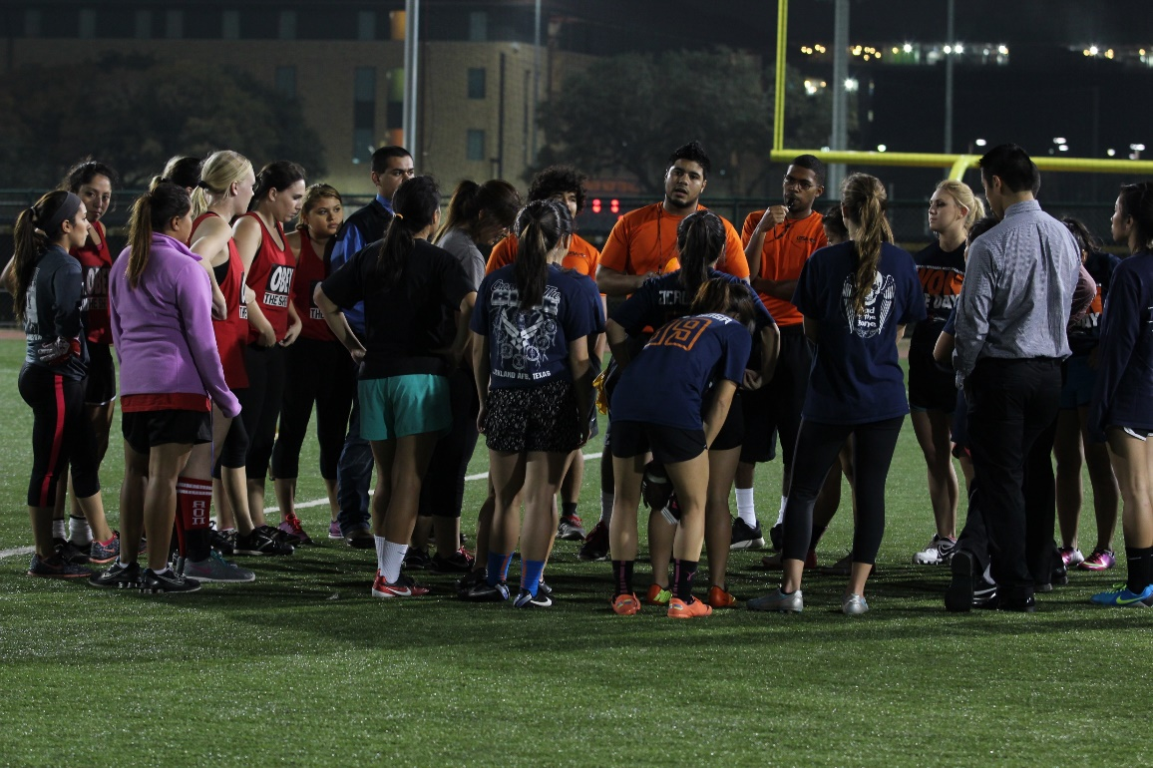
CUSTOMER SERVICE CONCEPTS
Preparation
Situational Awareness
Confidence
Consistency
Communication
Conflict Management
Notes:
Why are we talking about this?
How is COVID-19 impacting our need to revisit customer service concepts?

Slide 3
CUSTOMER SERVICE CONCEPTS
PREPARATION
Policy Knowledge
Study and review consistently
Helps to explain to patrons
Before Shift
Pre-shift discussion
Review policy
After Shift
Post-shift discussion
Report any concerns with supervisor
Pre-Shift Meeting
Review cleaning/disinfecting procedures
Review face covering guidelines
Review social distancing guidelines
Review difficult situation scenarios
Check your own PPE
Post-Shift Meeting
Debrief with team members/supervisor
Report any concerns/situations to supervisor
Discard used PPE (non-reusable mask, glove, etc)
Notes:
Provide examples specific to your area for each bullet point
What policies should staff be reviewing and knowledgeable about?
What are examples of pre-shift discussion expectations?
What are examples of post-shift discussions?

Slide 4
CUSTOMER SERVICE CONCEPTS
SITUATIONAL AWARENESS
As staff, we need to be aware of different situations to make correct decisions before approaching patrons.
Did the patron just finish cardio and that’s why their mask is off?
Did the patron just finish drinking water and that’s why their mask is off?
Emotions/Mood of the patron
Has staff already warned/talked to this patron?
Has this patron caused problems before?
Our awareness needs to increase during peak hours and/or at full capacity.
CONFIDENCE
Great knowledge of the policy and the capability of enforcing the policy
Having a strong presence
Trust your training/experience
Trust your team members
Do not overthink situations
CONSISTENCY
Anticipate mistakes
Speak to everyone with the same respect (faculty, staff, guests, etc)
Avoid reacting abruptly, give patrons an opportunity to correct themselves
Be aware of what happens on your shift
Notes:
Ask/provide examples of actual incidents that have occurred thus far.

Slide 5
CUSTOMER SERVICE CONCEPTS
COMMUNICATION
THE MOST IMPORANT ASPECT
Who do staff communicate with?
Supervisors
Team Members
Patrons
The keys to communicating with patrons
Show respect
Be relatable
Don’t be a “tough person”
Don’t yell!
Show confidence
Answer reasonable questions
Choose your words wisely
STAY COOL!!!

Slide 6
CUSTOMER SERVICE CONCEPTS
CONFLICT MANAGEMENT
Common comments said by patrons
Common Complaints
Questioning Policies
Utter Disrespect
Conflict Management Process
Ask – to properly wear face covering
Offer – options to follow policy
Leave – patron “IF” they do not comply with policy and have them escorted out
Report – any situations that caused trouble
Ways to manage conflict
Show dignity and respect toward patron
Listen to patron with all of your senses
Ask, don’t tell!!
Explain why?
Offer options, not threats
Give a second chance!
Notes:
Role Play:
Create scenarios specific to your area and ask your staff to practice addressing the patron.
Common complaints: Example- Why is there limited equipment?
Questioning Policy: Example- Why do I have to wear a mask?
Utter Disrespect: Example- COVID is a hoax and ya'll are just sheep following the conspiracy

Slide 7
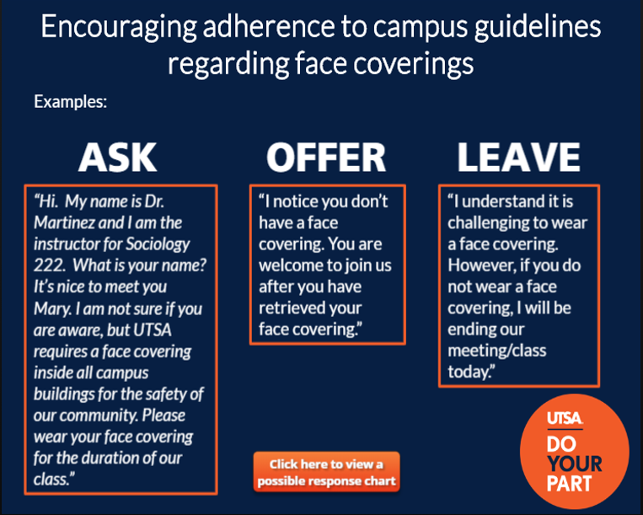
ASK-0FFER-LEAVE METHOD
The University has recommended using this method to encourage patrons to adhere to wearing face coverings on campus.
Notes:
PRACTICE

Slide 8
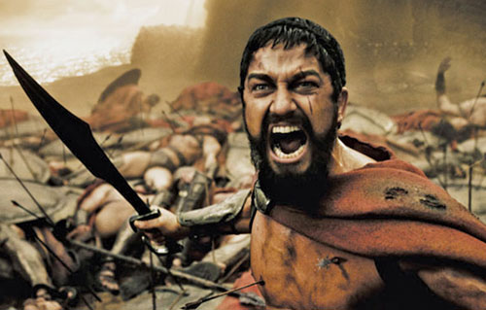
CUSTOMER SERVICE CONCEPTS
Follow these tips when dealing with upset patrons.
Always be professional, positive, and respectful
Approach in a friendly manner
Remain neutral and don’t take it personal
Listen without interrupting
Collect details by taking notes when they speak
Apologize ‘appropriately’
Confirm their concerns and repeat back
Offer choices on how to resolve the situation

